Slide 1

Risk Management Toolkit Overview and Approach
Confidential
Created by ex-McKinsey, Deloitte & BCG Management Consultants specialized in Risk Management

Slide 2
Key Definitions
Risk management is the culture, processes, and structures that are directed towards realising potential opportunities, whilst managing adverse effects.
A risk is a measure of the potential inability to achieve a goal or target within defined safety, cost, schedule, and technical constraints. A risk has two components: the likelihood of failing to achieve a particular outcome, and the consequence of failing to achieve it. A risk is a future event and can often be managed proactively.
An issue is a risk that has occurred and has become a problem. It is an undesirable event that has occurred and its occurrence cannot be stopped or directly controlled.
Risk assessment is the qualitative and/or quantitative evaluation of the likelihood and consequence of a risk occurring.
Likelihood is the probability of a specified outcome.
A closed risk is one that no longer exists (i.e., the risk has evolved into an issue or is no longer relevant), is no longer cost-effective to track, or has been mitigated.
A risk owner is an individual to whom a risk is assigned. The risk owner is responsible and accountable for identifying, implementing, and tracking the risk mitigation strategy and actions.

Slide 3
Context and objectives of having a clear risk management approach
Context
Risk management is an important function in organizations today. Companies undertake increasingly complex and ambitious initiatives, and those initiatives must be executed successfully, in an uncertain and often risky environment.
Objectives of having a clear risk management approach
Provide a systematic approach to the early identification and management of risks
Provide consistent risk assessment criteria
Make available accurate and concise risk information that informs decision making, including business direction
Adopt risk mitigation strategies that are cost-effective and efficient in reducing risk to an acceptable level
Monitor and review risk levels to ensure that risk exposure remains within an acceptable level

Slide 4
Benefits of risk management
1
Increase the likelihood of achieving the organization’s strategic and business objectives
2
Encourage a high standard of accountability at all levels of the organization
3
Support more effective decision making through better understanding of risk exposure
4
Create an environment that enables the organization to deliver timely services and meet performance objectives in an efficient and cost-effective manner
5
Safeguard the key assets of the organization: human, property, and reputation
6
Meet compliance and governance requirements

Slide 5






Content The Risk Management Toolkit was created by ex-McKinsey, Deloitte, and BCG management consultants specializing in risk management. It includes 7 components.
Tools
Frameworks
Templates
Toolkit
Support from tier-1 management consultants
Step-by-step tutorials
Best practices
Real-life examples

Slide 6
Objectives The Risk Management Toolkit includes frameworks, tools, templates, tutorials, real-life examples, and best practices to help you:
Define and implement your risk management strategy and plan: (1) Summary of the corporate and business strategy, (2) Risk appetite, (3) Risk management capability maturity model, (4) Risk management mission, vision, and strategic objectives, (5) Risk management KPIs, targets, and initiatives, (6) Roadmap to reach our strategic objectives, (7) Risk management team and budget, (8) Governance structure, (9) Guiding principles, (10) Framework to manage risk
Easily identify, assess, and mitigate the key risks and issues of your project or company by leveraging our risk management 7-phase approach, risk log, issue log, risk assessment matrix, and risk and issue dashboard
Prioritize your risks based on the potential impact of the risk and the probability of the risk to happen
Automatically calculate your number of high, medium, and low priority risks and issues with our risk and issue dashboard
Present a robust risk management approach and risk assessment overview to your board of directors, executive committee, or program manager
Get a high-level view of all your risks with our 3-by-3 risk prioritization matrix and 5-by-5 risk prioritization matrix

Slide 7


Scope of the Risk Management Toolkit
Strategic Risks
Long term
Project Risks
Medium term
Operational Risks
Short Term

Slide 8







Approach Our Risk Management Toolkit includes a simple 7-phase approach, which can be used to manage the risks and issues of a company or a project
1.Risk Management Strategy & Plan
2.Risk Identification
3.Risk Assessment
4.Risk Prioritization
5.Risk Mitigation
6.Risk Closure and Issue Escalation
7. Issue Management
Summary of the corporate and business strategy
Risk appetite
Risk management capability maturity model
Risk management mission, vision and strategic objectives
Risk management KPIs, targets and initiatives
Roadmap to reach our strategic objectives
Risk management team and budget
Governance structure
Guiding principles
Framework to manage risk
Risk types and examples
Tools to identify risks
Simple risk log in Powerpoint
Comprehensive risk log in Excel
Probability of the risk happening
Potential impact of the risk
Risk value
3-by-3 risk prioritization matrix in PowerPoint and Excel
5-by-5 risk prioritization matrix in PowerPoint and Excel
Response options
Examples
Actions, deadlines, and responsibilities
Dashboard
Risk closure
Issue escalation
Simple issue log in PowerPoint
Comprehensive issue log in Excel

Slide 9

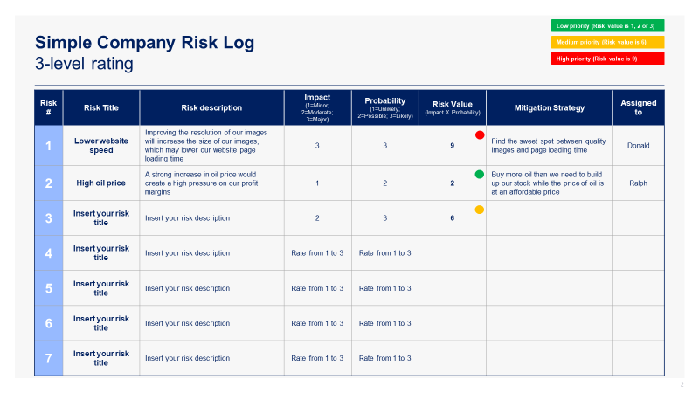
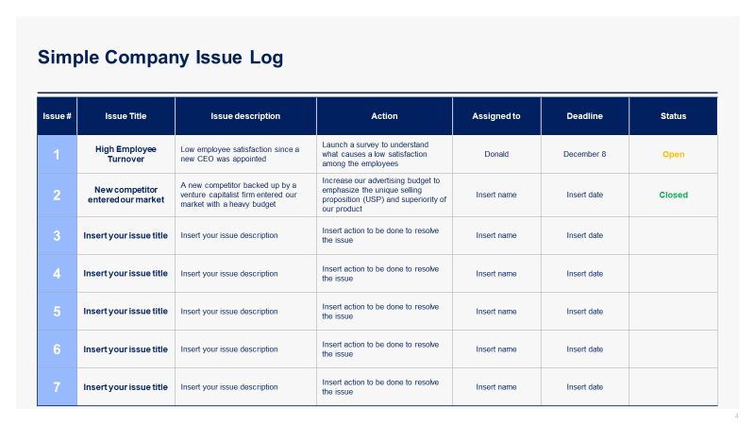
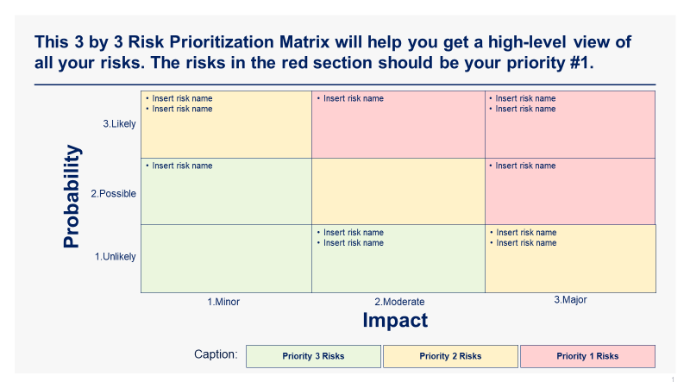
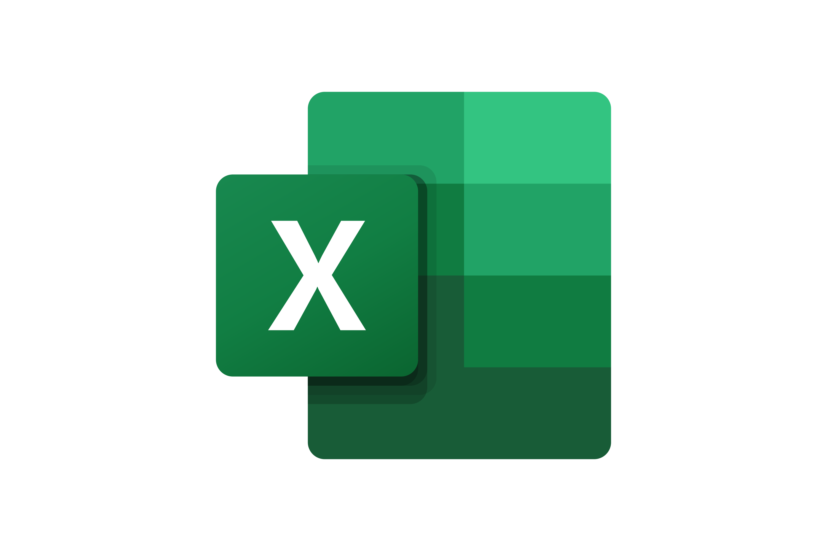
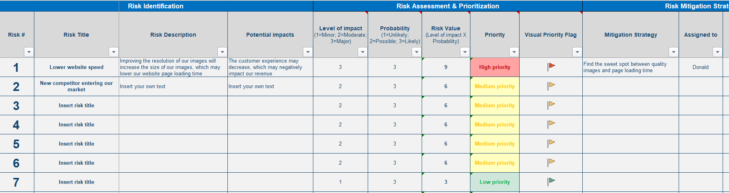
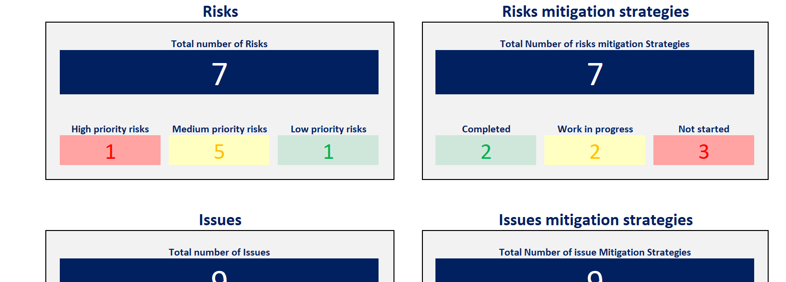
Tools and Templates To easily implement our 7-phase approach, we have created multiple tools in PowerPoint and Excel that can be used for both your company or a specific project
Simple Risk Log
Simple Issue Log
Risk Prioritization Matrix
Comprehensive Risk Log
Dashboard

Slide 10






In the next slides, you’ll see a small preview of Phase I
1.Risk Management Strategy & Plan
2.Risk Identification
3.Risk Assessment
4.Risk Prioritization
5.Risk Mitigation
6.Risk Closure and Issue Escalation
7. Issue Management
Summary of the corporate and business strategy
Risk appetite
Risk management capability maturity model
Risk management mission, vision, and strategic objectives
Risk management KPIs, targets, and initiatives
Roadmap to reach our strategic objectives
Risk management team and budget
Governance structure
Guiding principles
Framework to manage risk
Risk types and examples
Tools to identify risks
Simple risk log in Powerpoint
Comprehensive risk log in Excel
Probability of the risk happening
Potential impact of the risk
Risk value
3-by-3 risk prioritization matrix in PowerPoint and Excel
5-by-5 risk prioritization matrix in PowerPoint and Excel
Response options
Examples
Actions, deadlines, and responsibilities
Risk closure
Issue escalation
Simple issue log in PowerPoint
Comprehensive issue log in Excel

Slide 11
Introduction
You can use this deliverable directly for your own purposes. You simply need to insert your logo and adjust the slides based on the specificities of your organization.
Please note that this document also includes many slides with best practices, tutorials, and real-life examples to help you adjust this deliverable based on the specificities of your organization. These slides have an orange rectangle in their top-right corner. You may decide to delete these slides as they are mainly there to help you fill in the rest of the deliverable. Before you do, copy and paste this document so you always have the original version in case you need it.

Slide 12
What do we mean by risk appetite?
Risk appetite is the amount of risk an entity is willing to accept or retain in order to achieve its objectives. It is a statement or series of statements that describes the entity’s attitude toward risk taking. Determining an entity’s risk appetite occurs through the development of risk appetite statements which clearly set out what the executives consider to be acceptable risk-taking. Risk appetite statements are usually aligned to categories of risk (e.g., financial, people, and reputation risks).
Risk appetite statements will look and feel different according to an entity’s internal and external context. If these are not calibrated, the resultant actions may be skewed either too lightly (e.g., no action
required) or result in an over-controlled risk response.
To help us assess our organization’s risk appetite, we decided to use a risk appetite scale (see next slide).

Slide 13
What are the benefits of defining risk appetite?
Support conscious and informed risk taking
Promote a more consistent risk management approach
Guide risk decision making
Structure the executive conversation on risk taking
Calibrate the organization risk assessment process

Slide 14
Risk appetite scale
1 - Very low appetite
2 - Low appetite
2 - Moderate appetite
4 - High appetite
5 - Very high appetite
Insert your own text
Insert your own definition
Insert your own definition
Insert your own definition
Insert your own definition
Insert your own definition
Insert your own text
Insert your own definition
Insert your own definition
Insert your own definition
Insert your own definition
Insert your own definition
Insert your own text
Insert your own definition
Insert your own definition
Insert your own definition
Insert your own definition
Insert your own definition
Insert your own text
Insert your own definition
Insert your own definition
Insert your own definition
Insert your own definition
Insert your own definition

Slide 15
Risk appetite scale
Real-life example from a Fortune 500 company
1 - Very low appetite
2 - Low appetite
2 - Moderate appetite
4 - High appetite
5 - Very high appetite
Risk taking
The organization takes caution and often accepts as little risk as possible
The organization takes a cautious approach towards taking risk
The organization takes a balanced approach to risk taking
The organization is willing to take greater than normal risks
The organization believes aggressive risk taking is justified
Choice when faced with multiple options
Will select the lowest risk option, always
Will accept only if essential, and limited possibility/extent of failure
Will accept if limited, and heavily outweighed by benefits
Will choose to put at risk, but will manage impact
Will choose the option with the highest return; accept possibility of failure
Objective/negative impact relationship
Not willing to accept any potential negative impact in order to pursue strategic objectives
Only willing to accept a small potential negative impact in order to pursue strategic objectives
Potential negative impact and the completion of strategic objectives are given equal consideration
Willing to accept some potential negative impact to pursue strategic objectives
Willing to accept a potential large negative impact to pursue strategic objectives
Tolerance for uncertainty
Very low
Low
Limited
Expect some
Fully anticipated

Slide 16
Following multiple interviews and workshops, we assessed that the risk appetite of our organization was high [insert your own rating]
1 - Very low appetite
2 - Low appetite
2 - Moderate appetite
4 - High appetite
5 - Very high appetite
Risk taking
The organization takes caution and often accepts as little risk as possible
The organization takes a cautious approach towards taking risk
The organization takes a balanced approach to risk taking
The organization is willing to take greater than normal risks
The organization believes aggressive risk taking is justified
Choice when faced with multiple options
Will select the lowest risk option, always
Will accept only if essential, and limited possibility/extent of failure
Will accept if limited, and heavily out-weighted by benefits
Will choose to put at risk, but will manage impact
Will choose the option with the highest return; accept possibility of failure
Objective/ negative impact relationship
Not willing to accept any potential negative impact in order to pursue strategic objectives
Only willing to accept a small potential negative impact in order to pursue strategic objectives
Potential negative impact and the completion of strategic objectives are given equal consideration
Willing to accept some potential negative impact to pursue strategic objectives
Willing to accept a potential large negative impact to pursue strategic objectives
Tolerance for uncertainty
Very low
Low
Limited
Expect some
Fully anticipated

Slide 17
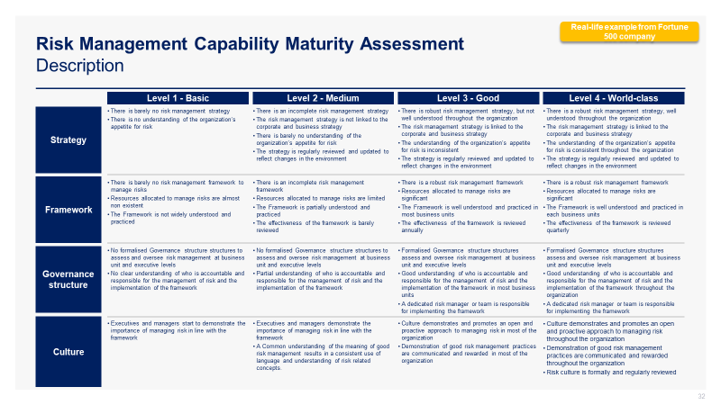
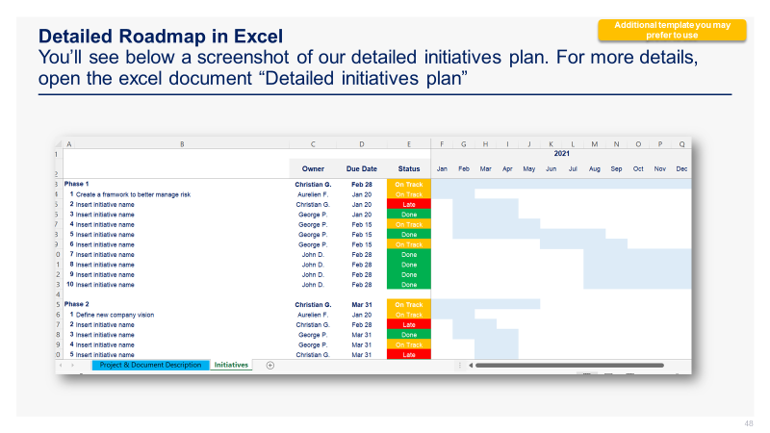
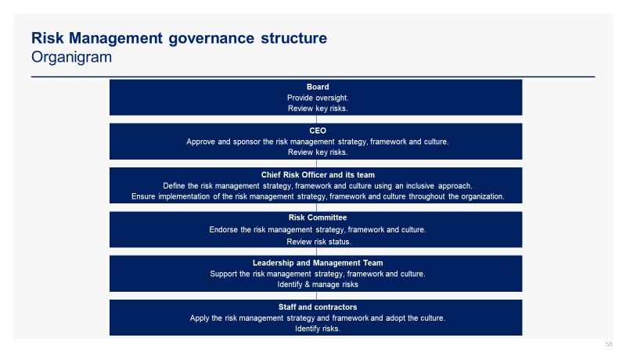
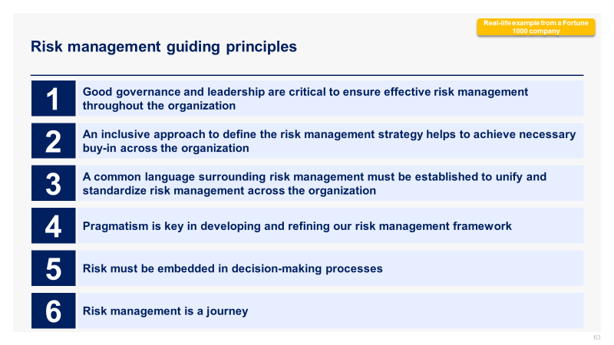
See below 4 screenshots from Phase I.
Screenshots
Risk Management Capability Maturity Assessment
Detailed Roadmap in Excel
Governance Structure
Guiding Principles

Slide 18

In the next slides, you’ll see a small preview of Phase II
1.Risk Management Strategy & Plan
2.Risk Identification
3.Risk Assessment
4.Risk Prioritization
5.Risk Mitigation
6.Risk Closure and Issue Escalation
7. Issue Management
Summary of the corporate and business strategy
Risk appetite
Risk management capability maturity model
Risk management mission, vision and strategic objectives
Risk management KPIs, targets and initiatives
Roadmap to reach our strategic objectives
Risk management team and budget
Governance structure
Guiding principles
Framework to manage risk
Risk types and examples
Tools to identify risks
Simple risk log in Powerpoint
Comprehensive risk log in Excel
Probability of the risk happening
Potential impact of the risk
Risk value
3-by-3 risk prioritization matrix in PowerPoint and Excel
5-by-5 risk prioritization matrix in PowerPoint and Excel
Response options
Examples
Actions, deadlines, and responsibilities
Dashboard
Risk closure
Issue escalation
Simple issue log in PowerPoint
Comprehensive issue log in Excel

Slide 19
Simple risk log Description
To identify our company risks and project risks, we created a simple risk log in PowerPoint.
This simple risk log will be used when our list of risks is small or if we need to make a presentation in front of our Board of Directors, Executive Committee, or any stakeholders that do not need to know too many details.

Slide 20
Simple risk log 3-level rating
Low priority (risk value is 1, 2, or 3)
Medium priority (risk value is 6)
High priority (risk value is 9)
Risk # | Risk Title | Risk Description | Impact (1=Minor; 2=Moderate; 3=Major) | Probability (1=Unlikely; 2=Possible; 3=Likely) | Risk Value (Impact X Probability) | Mitigation Strategy | Assigned To
1 | Lower website speed | Improving the resolution of our images will increase the size of our images, which may lower our website page loading time | 3 | 3 | 9 | Find the sweet spot between quality images and page loading time | Donald
2 | High oil price | A strong increase in oil price would create a high pressure on our profit margins | 1 | 2 | 2 | Buy more oil than we need to build up our stock while the price of oil is at an affordable price | Ralph
3 | Insert your risk title | Insert your risk description | 2 | 3 | 6
4 | Insert your risk title | Insert your risk description | Rate from 1 to 3 | Rate from 1 to 3
5 | Insert your risk title | Insert your risk description | Rate from 1 to 3 | Rate from 1 to 3
6 | Insert your risk title | Insert your risk description | Rate from 1 to 3 | Rate from 1 to 3
7 | Insert your risk title | Insert your risk description | Rate from 1 to 3 | Rate from 1 to 3

Slide 21
Comprehensive risk log Description
To identify our company risks and project risks, we created a comprehensive risk log in Excel.
This comprehensive risk log will be used when we have a long list of risks and need to provide a lot of details for each of them.
Comprehensive Risk Log in Excel (for more details, open the Excel document “Comprehensive Risk Log”

Slide 22
In the next slides, you’ll see a small preview of Phase III
1.Risk Management Strategy & Plan
2.Risk Identification
3.Risk Assessment
4.Risk Prioritization
5.Risk Mitigation
6.Risk Closure and Issue Escalation
7. Issue Management
Summary of the corporate and business strategy
Risk appetite
Risk management capability maturity model
Risk management mission, vision, and strategic objectives
Risk management KPIs, targets, and initiatives
Roadmap to reach our strategic objectives
Risk management team and budget
Governance structure
Guiding principles
Framework to manage risk
Risk types and examples
Tools to identify risks
Simple risk log in PowerPoint
Comprehensive risk log in Excel
Probability of the risk happening
Potential impact of the risk
Risk value
3-by-3 risk prioritization matrix in PowerPoint and Excel
5-by-5 risk prioritization matrix in PowerPoint and Excel
Response options
Examples
Actions, deadlines, and responsibilities
Dashboard
Risk closure
Issue escalation
Simple issue log in PowerPoint
Comprehensive issue log in Excel

Slide 23
By multiplying the “Probability” dimension by the “Impact” dimension, we will get our “Risk Value”
Probability
Impact
Risk Value
What is the probability of the risk happening
What is the potential impact of the risk
The risk value will help you prioritize your risks
X
=

Slide 24
To assess the probability of a risk happening, we can use a 3-level or 5-level rating depending on our needs
Probability 3-level rating
Probability Scale
Definition
3.Likely
Over 60% chances of happening
2.Possible
Between 20% and 60% chance of happening
1.Unlikely
Less than 20% chance of happening

Slide 25
In the next slides, you’ll see a small preview of Phase IV
1.Risk Management Strategy & Plan
2.Risk Identification
3.Risk Assessment
4.Risk Prioritization
5.Risk Mitigation
6.Risk Closure and Issue Escalation
7. Issue Management
Summary of the corporate and business strategy
Risk appetite
Risk management capability maturity model
Risk management mission, vision and strategic objectives
Risk management KPIs, targets and initiatives
Roadmap to reach our strategic objectives
Risk management team and budget
Governance structure
Guiding principles
Framework to manage risk
Risk types and examples
Tools to identify risks
Simple risk log in PowerPoint
Comprehensive risk log in Excel
Probability of the risk happening
Potential impact of the risk
Risk value
3-by-3 risk prioritization matrix in PowerPoint and Excel
5-by-5 risk prioritization matrix in PowerPoint and Excel
Response options
Examples
Actions, deadlines, and responsibilities
Dashboard
Risk closure
Issue escalation
Simple issue log in PowerPoint
Comprehensive issue log in Excel

Slide 26
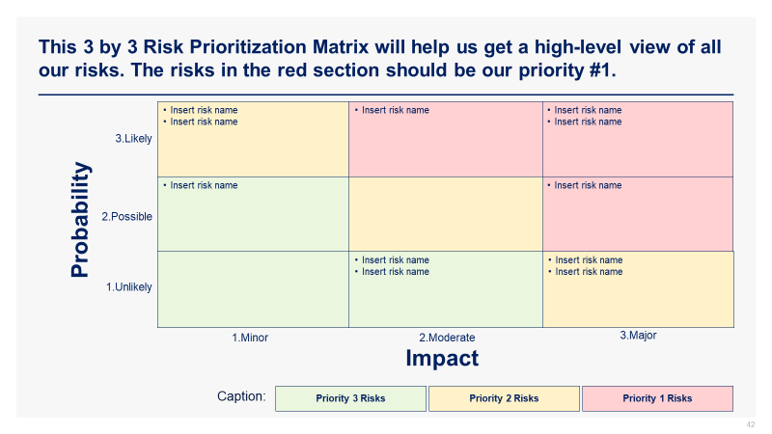
See below 1 screenshot from Phase IV
Screenshots
Risk Prioritization Matrix

Slide 27
In the next slides, you’ll see a small preview of Phase V
1.Risk Management Strategy & Plan
2.Risk Identification
3.Risk Assessment
4.Risk Prioritization
5.Risk Mitigation
6.Risk Closure and Issue Escalation
7. Issue Management
Summary of the corporate and business strategy
Risk appetite
Risk management capability maturity model
Risk management mission, vision and strategic objectives
Risk management KPIs, targets and initiatives
Roadmap to reach our strategic objectives
Risk management team and budget
Governance structure
Guiding principles
Framework to manage risk
Risk types and examples
Tools to identify risks
Simple risk log in PowerPoint
Comprehensive risk log in Excel
Probability of the risk happening
Potential impact of the risk
Risk value
3-by-3 risk prioritization matrix in PowerPoint and Excel
5-by-5 risk prioritization matrix in PowerPoint and Excel
Response options
Examples
Actions, deadlines and responsibilities
Dashboard
Risk closure
Issue escalation
Simple issue log in PowerPoint
Comprehensive issue log in Excel

Slide 28
We identified 6 types of mitigation strategies
Avoid a threat
This option is about making the uncertain situation certain by removing the risk, often by removing the cause of the threat
Reduce a threat
This option is about taking action now to change the probability and/or impact of a threat
Transfer the risk
This option is about transferring part of the risk to a third party(e.g., taking out an insurance policy)
Share the risk
This option is about sharing the risk with another entity or multiple entities in order to minimize the potential impact on one single entity
Accept the risk
This option means that the organisation decides to accept that a risk may occur and to take no action, exposing itself to the full possible impact
Prepare a contingency plan
This option means that the organisation decides to accept that a risk may occur and to take no immediate action, but puts in place a series of contingencies to deal with the potential impact

Slide 29
We will define and implement our mitigation strategies by using our comprehensive risk log in Excel

Slide 30
We will monitor the implementation of our mitigation strategies by leveraging our dashboard in Excel, which will automatically be updated based on the input we make in the risk log

Slide 31

Structure of the Toolkit The Risk Management Toolkit includes 100 PowerPoint slides and 10 Excel sheets that you can download on your device immediately after your purchase.
+
100 editable PowerPoint slides*
10 editable Excel sheets*
1. Risk Management Strategy and Plan
2. Risk Identification
3. Risk Assessment
4. Risk Prioritization
5. Risk Mitigation
6. Risk Closure and Issue Escalation
7. Issue Management
*Please note that the number of PowerPoint slides and Excel sheets listed is the number of unique slides and sheets. For example, a PowerPoint slide that has been duplicated to facilitate our clients’ understanding only counts for 1 slide.

Slide 32









Key Benefits of our Management Consulting Toolkits
Improve the growth & efficiency of your organization by leveraging Management Consulting Toolkits created by ex-McKinsey, Deloitte & BCG Consultants.
It’s like hiring Management Consultants to create all the practical Frameworks, Tools & Templates required to gain a competitive advantage.
We invested $3M to create all our Management Consulting Toolkits. Get them for a fraction of that.
Get the job done quicker and never start from scratch again with our ready-made and fully editable Frameworks, Tools & Templates in Powerpoint & Excel.
We have worked 20,000+ hours over the past 9 years to create the world’s best Management Consulting Toolkits. Don’t reinvent the wheel. Download them now.
Improve your skills & capabilities and meet your professional goals by learning how the Fortune 100 and Global Consulting Firms do it.
Hiring top-tier Consultants for a management consulting project would cost you $300k+. That’s a lot more expensive than purchasing our Toolkits.
Impress your stakeholders and become your organization’s subject matter expert with world-class approaches to resolve common business problems.
Get free support and advice from our ex-McKinsey, Deloitte & BCG Management Consultants.

Slide 33
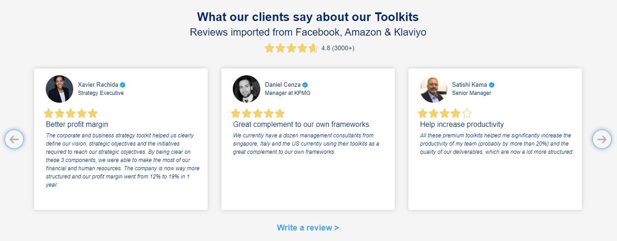
What our clients say about our Toolkits Reviews imported from Facebooks, Amazon and Klaviyo
See more reviews >

Slide 34

Join the 200,000+ Executives, Consultants & Entrepreneurs already leveraging our Business & Consulting Toolkits to improve the performance of their organization and boost their own career.
Trusted by small and large organizations
Customer satisfaction
4.8
Number of countries leveraging our Business & Consulting Toolkits
160+
Number of professionals leveraging our Business & Consulting Toolkits
200,000+
Daily rate of our ex-McKinsey, Deloitte and BCG Management Consultants
$3k-$4k

Slide 35
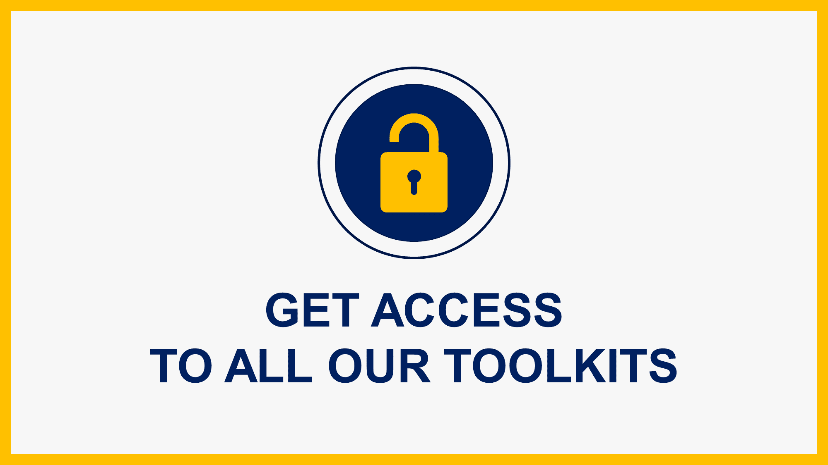
Interested in more than 1 Toolkit? Access all our Toolkits for half the price with our Gold Access
Gold Access
Click here to learn more

Slide 36

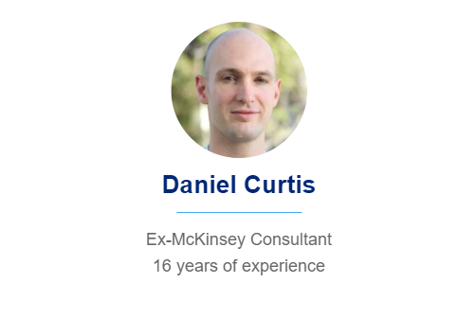
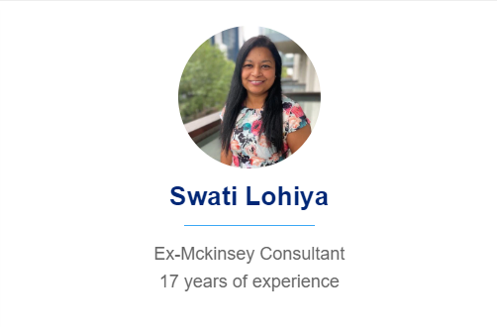
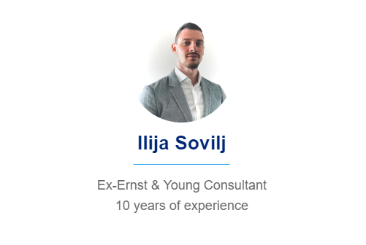
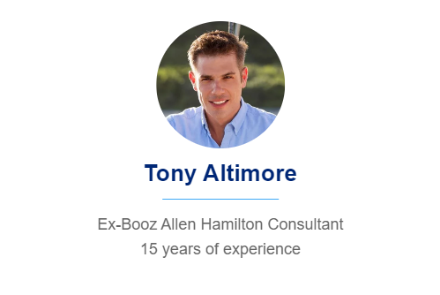
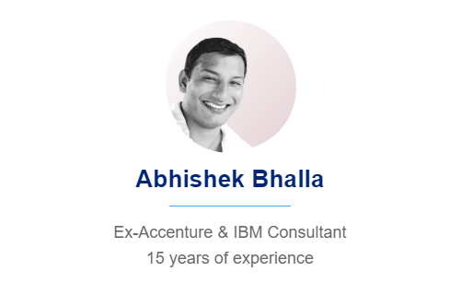
Need additional help on top of our Management Consulting Toolkits? Send us a brief and we’ll find you the right talent from our network of 500 tier-1 Management Consultants (the average daily rate is $3k)
Click here to send us a Project Brief

Slide 37
This was just a small preview.
www.domontconsulting.com

